Slide 1
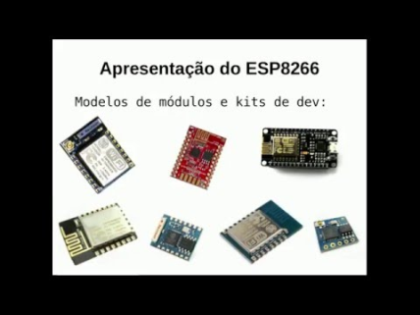
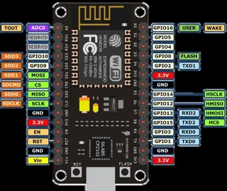
Smart Plugs for Building Energy Management Systems
Members name & Id:
Name: Md.Murad Name: Md.Mubassirul Islam Name: Md.Shamsul Alam Momin
Id:161060042 Id:172007042 Id:171019042
Name: Isse abud hussein Name: Mohamed salah awil
Id:192012042 id: 192026042
Computer science & engineering department
Primeasia university ,Dhaka, Bangladesh .
Abstract
Due to rising value of energy supplies, the need for managing electrical energy sources becomes prominent. In this paper, a smart plug device is presented; which provides features to measure energy consumption and recognizes type of attached electrical devices. Furthermore, the proposed framework enables home controller systems to monitor and control home energy consumption efficiently. Subsequently an analysis of energy consumption of a pilot house, prior and after the installation of the smart plug, based on a hypothetical scenario, is provided. The results present positive impacts of using the smart plug on energy consumption rate; especially during peak hours. Keywords- smart grid; energy consumption pattern; home automation; industrial communication; demand-side management; smart plug; smart environment. I. INTRODUCTION Electrical energy consumption of residential consumers in Iran in the period from April 2008 to April 2009 is reported to be about 52.896 GWh; which is 33% of the entire energy consumption in the country [1]. In addition, the residential electrical energy consumption in Iran is predicted to increase about 2.2 times until 2016 [2]. Thus, correction and peak shaving of residential consumption distribution will have a considerable effect on total consumption reduction during peak hours. Moreover, this reduction may lead to shut down of gas power plants and subsequently reduction of CO2 emission and global warming [3]. One of the main challenges in providing household electricity is non-uniform daily energy usage. Namely, the level of energy production and consumption cost in peak hours becomes significantly higher than off-peak hours. Hence, moving energy usage period to off-peak hours does not change the amount of energy usage significantly but can be helpful for reducing energy provision costs. Demand-side power monitoring methods which are implemented on the user side [4] do to not requiring new infrastructure set up and therefore have low implementation cost. Extensive research proposes a number of demand-side solutions addressing challenges in the field of energy consumption.
SMART PLUG DESIGN AND PROTOTYPING In this technology smart plugs are connected to the main unit via twisted wires. After plugging in a device, smart plug determines the device tag (Table 1) of appliance by its magnetic sensors and sends the encoded type to the main unit, i.e., the home controller system. Also the plug calculates the energy usage and the energy quality of the appliance by its internal sensors and sends the collected data to the processing unit for monitoring, decision making, and data storage. Central controller is able to send commands to switch each specific plug on/off depending on the energy management program loaded on it.
Fig. esp8266 module
Fig. esp8266 module pin

Slide 2
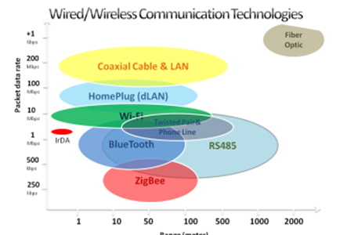
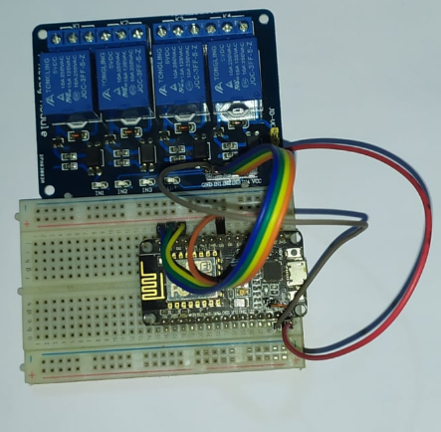
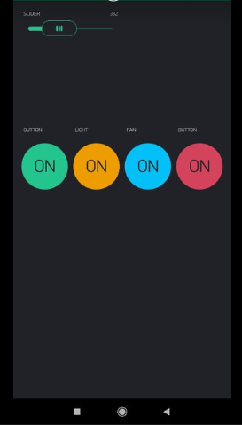
DATA COMMUNICATION Due to low price and low complexity of RS-485 bus, this communication technology is chosen for the prepared prototype of the smart plug. There are number of alternatives for the communication subsystem which can be adopted in our design. These technologies are divided into two categories of wired communications and wireless communications; each having its own advantages and disadvantages. Figure 3 demonstrates a comparison between technologies used in both of these categories with respect to the range and packet data rate.
Fig: all control system on smart plug
Fig: device architecture
Fig: control apps
CONCLUSIONS
This paper presents a simple algorithm implementation to indicate a consumption reduction during peak hours using smart meter functionalities. This can be extended by using more developed algorithms and connecting the plug to advanced home control systems. A hardware implementation of the discussed smart plugs is discussed in this work and the methods for tagging each appliance by this device for controlling the energy consumption are described. The proposed energy management system was evaluated by use of emulated available data from Tavanir organisation. The peak-shaving and ToD methods applied on the emulated data demonstrate between 10%-22% gain which is resulted by the energy consumption management system.
ACKNOWLEDGMETNT
The authors would like to thank the Greater Tehran Electricity Distribution Company (GTEDC) for their collaboration and support.
REFERENCES
https://www.instructables.com/id/The-Smart-Multiplug/
https://www.hackster.io/taifur/smart-plug-b653f2
https://www.kickstarter.com/projects/337922278/smart-power-strip-control-your-appliances-from-any
http://ijettjournal.org/2018/volume-55/number-2/IJETT-V55P212.pdf
https://electronicsforu.com/electronics-projects/electronics-design-guides/smart-power-plug

